Slide 1
Parallel and Asynchronous Functional Programming on .NET with F#
Don Syme
Senior Researcher, Microsoft Research, Cambridge

Slide 2
Session Prerequisites
TLA407: Joe Duffy: Dealing with Concurrency and Multi-Core CPUs with Today’s Development Technologies

Slide 3
Session Objectives and Agenda
Introducing F#
F# Asynchronous Workflows for Reactive Programming
F# and Parallel FX

Slide 4
F#: Combining Paradigms
Functional
Strong Typing
Succinct
Type Inference
Data Types and Patterns
1st Class Functions
Meta-Programming
Objects
.NET OO Model
Interoperable
Compact type-inferred classes
.NET
Visual Studio
Libraries
Tools
Concurrency
LINQ
Tools
F# Compiler
F# Interactive
Visual Studio Integration
Extensible Plotting
Lex and Yacc

Slide 5
F#: The Combination Counts!
Statically Typed
Succinct
F#
Libraries
Explorative
Interoperable
Efficient
Scalable

Slide 6
Orthogonal & Unified Constructs
Type inference. The safety of C# with the succinctness of a scripting language
Let “let” simplify your life…
Bind a static value
let data = (1,2,3)
let f(a,b,c) =
let sum = a + b + c
let g(x) = sum + x*x
g(a), g(b), g(c)
Bind a static function
Bind a local value
Bind a local function

Slide 7
Orthogonal & Unified Constructs
Functions: like delegates + unified and simple
One simple
mechanism,
many
uses
Anonymous
Function value
(fun x -> x + 1)
let f(x) = x + 1
(f,f)
val f : int -> int
predicate = 'a -> bool
send = 'a -> unit
Declare a
function value
threadStart = unit -> unit
A pair
of function values
comparer = 'a -> 'a -> int
hasher = 'a -> int
A function type
equality = 'a -> 'a -> bool

Slide 8
Immutability the norm…
let PI = 3.1415
PI <- 4.0
Data is immutable by default
✗!
type Person =
{ Name : string;
Birth : DateTime; }
let bob = {Name = "bob";
Birth= new DateTime(1,10,1970)}
bob.Birth <- new DateTime(1,10,1969)
Values may not be changed
✗!

Slide 9
F# - Functional
let f x = x+1
let pair x = (x,x)
let fst (x,y) = x
let data = (Some [1;2;3], Some [4;5;6])
match data with
| Some(nums1), Some(nums2) -> nums1 @ nums2
| None, Some(nums) -> nums
| Some(nums), None -> nums
| None, None -> failwith "missing!"

Slide 10
F# - Functional
List.map Seq.fold
Array.filter Lazy.force Set.union
Map LazyList Events Async...
[ 0..1000 ]
[ for x in 0..10 -> (x, x * x) ]
[| for x in 0..10 -> (x, x * x) |]
seq { for x in 0..10 -> (x, x * x) }
Range
Expressions
List via query
Array via query
IEnumerable
via query

Slide 11
F# - Imperative + Functional
Using .NET collections
open System.Collections.Generic
let dict = new Dictionary<int,string>(1000)
dict.[17] <- "Seventeen"
dict.[1000] <- "One Grand"
for (KeyValue(k,v)) in dict do
printfn "key = %d, value = %s" k v
Mutation when you need it
Side effects when you need them

Slide 12
F# - Imperative + Functional
“use” =
C# “using”
open System.IO
open System.Collections.Generic
let readAllLines(file) =
use inp = File.OpenText file
let res = new List<_>()
while not(inp.EndOfStream) do
res.Add(inp.ReadLine())
res.ToArray()
Localization and Separation

Slide 13
F# - Imperative + Functional
Read lines on demand
open System.IO
let allLines =
seq { use inp = File.OpenText "test.txt"
while not(inp.EndOfStream) do
yield (inp.ReadLine()) }
allLines
|> Seq.truncate 1000
|> Seq.map (fun s -> uppercase s,s)
|> Seq.to_array
Pipelines

Slide 14
Demo: Let’s WebCrawl…

Slide 15
F# - Objects + Functional
type Vector2D(dx:double,dy:double) =
member v.DX = dx
member v.DY = dy
member v.Length = sqrt(dx*dx+dy*dy)
member v.Scale(k) = Vector2D(dx*k,dy*k)
Inputs to object construction
Exported properties
Exported method

Slide 16
F# - Objects + Functional
type Vector2D(dx:double,dy:double) =
let norm2 = dx*dx+dy*dy
member v.DX = dx
member v.DY = dy
member v.Length = sqrt(norm2)
member v.Norm2 = norm2
Internal (pre-computed) values and functions

Slide 17
F# - Objects + Functional
type Vector2D(dx:double,dy:double) =
let mutable currDX = dx
let mutable currDX = dy
member v.DX = currDX
member v.DY = currDY
member v.Move(x,y) =
currDX <- currDX+x
currDY <- currDY+y
Internal state
Publish internal state
Mutate internal state

Slide 18
F# - Objects + Functional
Immutable inputs
type MyTable(data: Set<string>) =
let table1 =
HashMultiMap.Create
[ for x in data -> x.Length,x ]
member x.GetStringsWithLength(n) =
table1.FindAll(n)
member x.GetStrings() = data
member x.NumStrings = data.Length
Internal tables
Publish access

Slide 19
F# - Language Oriented
Embedded Language
type PropLogic =
| And of PropLogic * PropLogic
| Not of PropLogic
| True
let rec Eval(prop) =
match prop with
| And(a,b) -> Eval(a) && Eval(b)
| Not(a) -> not (Eval(a))
| True -> true
Crisp Semantics

Slide 20
F# - What is it For?
F# is “A Bridge Language”
“A Language Both Researchers and Developers Can Speak”
Scientific data analysis
Data mining
Domain-specific modeling
F# is for language related tasks
Manipulating concrete formats
Implementing Domain Specific Languages
Compilation, Analysis, Transformation

Slide 21
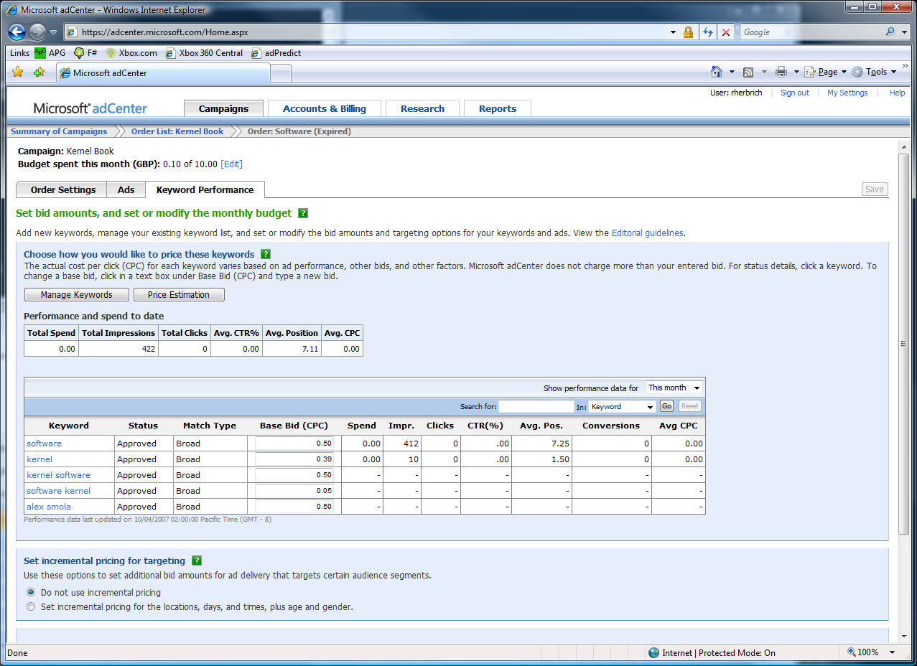

The adCenter Problem
Cash-cow of Search
Selling “web space” at www.live.com and www.msn.com.
“Paid Search” (prices by auctions)
The internal competition focuses on Paid Search.

Slide 22
The Scale of Things
Weeks of data in training:
7,000,000,000 impressions, 6TB data
2 weeks of CPU time during training:
2 wks × 7 days × 86,400 sec/day =
1,209,600 seconds
Learning algorithm speed requirement:
5,787 impression updates / sec
172.8 μs per impression update

Slide 23
F# and adCenter
4 week project, 4 machine learning experts
100million probabilistic variables
Processes 6TB of training data
Real time processing

Slide 24
APG Machine Learning
F#’s type inference means less typing, more thinking
Observations
Quick Coding
Agile Coding
Scripting
Performance
Memory-Faithful
Succinct
Symbolic
.NET Integration
Type-inferred functional/ OO code is easily factored and re-used
Interactive “hands-on” exploration of algorithms and data over smaller data sets. Used in combination with Excel
Immediate scaling to massive data sets
mega-data structures, 16GB machines
Live in the domain, not the language
Schema compilation and efficient “Schedule” representations key to success
Especially Excel, SQL Server

Slide 25

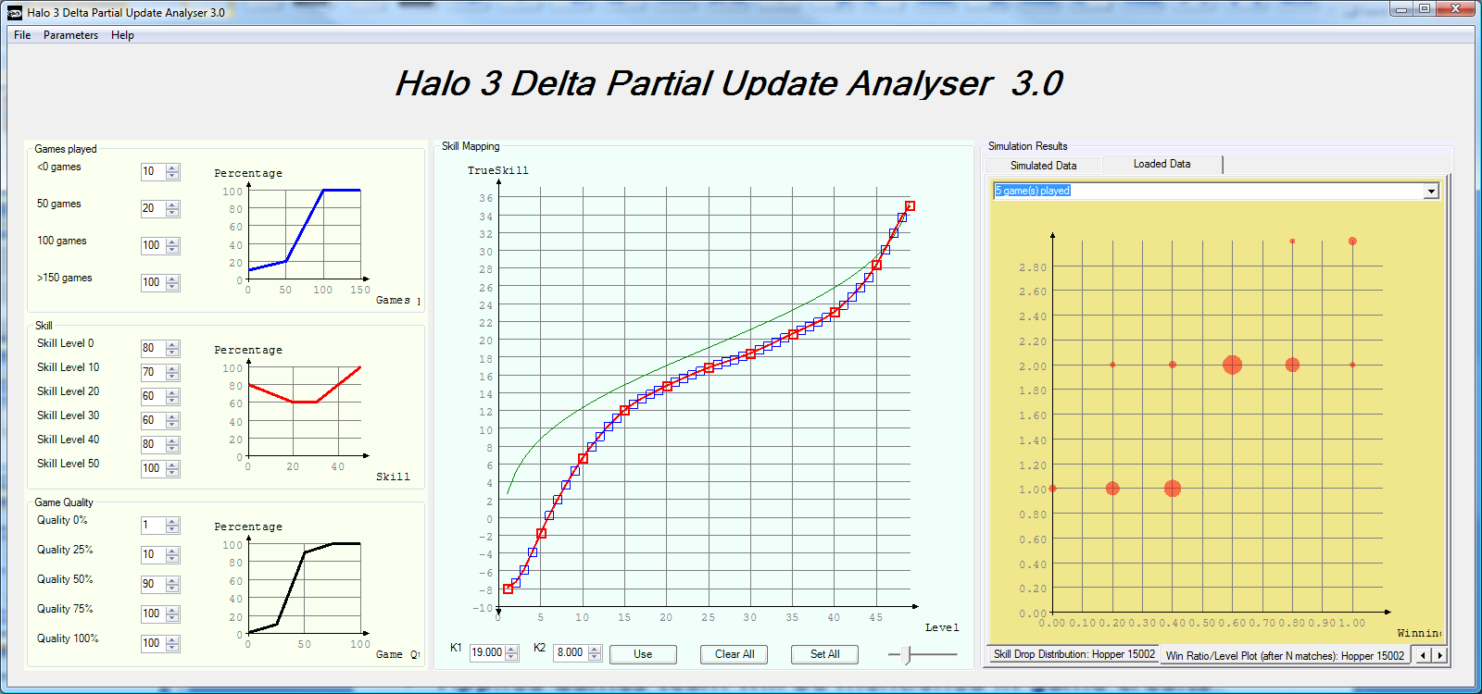
TrueSkill in Halo 3
TrueSkill extensions developed and deployed
Partial updates: Progressive Hill-climbing experience
Skill transformation: Linking skill- and experience-based ranking (monotonically increasing smooth splines)
Public beta-test 2007
Simulation of level distribution (2006) matched almost exactly findings during the beta test (2007).
From a consumer entertainment standpoint, comparable to Spiderman 3 or Harry Potter (Shane Kim).
Applied Games team will be mentioned in game credits

Slide 26
Challenges of modern language design
Statically typed, hence
Scalable (> 100K LOC)
It’s the
combination that counts!
Succinct
Safe
Efficient
Libraries
Interactive
Interoperable
Good
Platform

Slide 27
F# - Concurrent/Reactive/Parallel
Concurrent: Multiple threads of execution
Parallel: These execute simultaneously
Asynchronous: Computations that complete "later"
Reactive: Waiting and responding is normal

Slide 28
F# - Concurrent/Reactive/Parallel
Concurrent: Multiple threads of execution
Parallel: These execute simultaneously
Asynchronous: Computations that complete "later"
Reactive: Waiting and responding is normal

Slide 29
Some Foundation Technologies
.NET/Win32 Threads
System.Threading
.NET Thread Pool
.NET BackgroundWorker and SynchronizationContexts
ParallelWorker

Slide 30
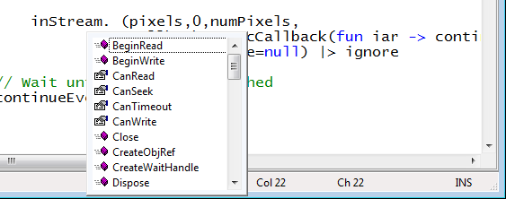
Taming Asynchronous I/O
Target: make it easy to use Begin/End operations
Stream.BeginRead : ...
Stream.EndRead : IAsyncResult * ...

Slide 31
Taming Asynchronous I/O
Typical Control Flow
Compositional
thread-hopping?
BeginRead
EndRead
Rest of Task

Slide 32
Taming Asynchronous I/O
ReadAsync
Rest of Task

Slide 33
Simple Examples
Compute 22 and 7 in parallel
Async.Parallel [ async { -> 2*2 + 3*6 };
async { -> 3 + 5 - 1 } ]
Get these three web pages and wait until all have come back
Async.Parallel [WebRequest.Async "http://www.live.com";
WebRequest.Async "http://www.yahoo.com";
WebRequest.Async "http://www.google.com" ]
let parArrMap f (arr: _[]) =
Async.Run (Async.Parallel [| for x in arr -> async { -> f x } |])
Naive Parallel Array Map
Note: ParallelFX much better here!

Slide 34
Demo: Asynchronous Workflows By Example
Don Syme

Slide 35
Taming Asynchronous I/O
using System;
using System.IO;
using System.Threading;
public class BulkImageProcAsync
{
public const String ImageBaseName = "tmpImage-";
public const int numImages = 200;
public const int numPixels = 512 * 512;
// ProcessImage has a simple O(N) loop, and you can vary the number
// of times you repeat that loop to make the application more CPU-
// bound or more IO-bound.
public static int processImageRepeats = 20;
// Threads must decrement NumImagesToFinish, and protect
// their access to it through a mutex.
public static int NumImagesToFinish = numImages;
public static Object[] NumImagesMutex = new Object[0];
// WaitObject is signalled when all image processing is done.
public static Object[] WaitObject = new Object[0];
public class ImageStateObject
{
public byte[] pixels;
public int imageNum;
public FileStream fs;
}
public static void ReadInImageCallback(IAsyncResult asyncResult)
{
ImageStateObject state = (ImageStateObject)asyncResult.AsyncState;
Stream stream = state.fs;
int bytesRead = stream.EndRead(asyncResult);
if (bytesRead != numPixels)
throw new Exception(String.Format
("In ReadInImageCallback, got the wrong number of " +
"bytes from the image: {0}.", bytesRead));
ProcessImage(state.pixels, state.imageNum);
stream.Close();
// Now write out the image.
// Using asynchronous I/O here appears not to be best practice.
// It ends up swamping the threadpool, because the threadpool
// threads are blocked on I/O requests that were just queued to
// the threadpool.
FileStream fs = new FileStream(ImageBaseName + state.imageNum +
".done", FileMode.Create, FileAccess.Write, FileShare.None,
4096, false);
fs.Write(state.pixels, 0, numPixels);
fs.Close();
// This application model uses too much memory.
// Releasing memory as soon as possible is a good idea,
// especially global state.
state.pixels = null;
fs = null;
// Record that an image is finished now.
lock (NumImagesMutex)
{
NumImagesToFinish--;
if (NumImagesToFinish == 0)
{
Monitor.Enter(WaitObject);
Monitor.Pulse(WaitObject);
Monitor.Exit(WaitObject);
}
}
}
public static void ProcessImagesInBulk()
{
Console.WriteLine("Processing images... ");
long t0 = Environment.TickCount;
NumImagesToFinish = numImages;
AsyncCallback readImageCallback = new
AsyncCallback(ReadInImageCallback);
for (int i = 0; i < numImages; i++)
{
ImageStateObject state = new ImageStateObject();
state.pixels = new byte[numPixels];
state.imageNum = i;
// Very large items are read only once, so you can make the
// buffer on the FileStream very small to save memory.
FileStream fs = new FileStream(ImageBaseName + i + ".tmp",
FileMode.Open, FileAccess.Read, FileShare.Read, 1, true);
state.fs = fs;
fs.BeginRead(state.pixels, 0, numPixels, readImageCallback,
state);
}
// Determine whether all images are done being processed.
// If not, block until all are finished.
bool mustBlock = false;
lock (NumImagesMutex)
{
if (NumImagesToFinish > 0)
mustBlock = true;
}
if (mustBlock)
{
Console.WriteLine("All worker threads are queued. " +
" Blocking until they complete. numLeft: {0}",
NumImagesToFinish);
Monitor.Enter(WaitObject);
Monitor.Wait(WaitObject);
Monitor.Exit(WaitObject);
}
long t1 = Environment.TickCount;
Console.WriteLine("Total time processing images: {0}ms",
(t1 - t0));
}
}
let ProcessImageAsync () =
async { let inStream = File.OpenRead(sprintf "Image%d.tmp" i)
let! pixels = inStream.ReadAsync(numPixels)
let pixels' = TransformImage(pixels,i)
let outStream = File.OpenWrite(sprintf "Image%d.done" i)
do! outStream.WriteAsync(pixels')
do Console.WriteLine "done!" }
let ProcessImagesAsyncWorkflow() =
Async.Run (Async.Parallel
[ for i in 1 .. numImages -> ProcessImageAsync i ])
Processing 200 images in parallel

Slide 36
Taming Asynchronous I/O
Open the file, synchronously
Equivalent F# code
(same perf)
Read from the file,
asynchronously
let ProcessImageAsync(i) =
async { let inStream = File.OpenRead(sprintf "source%d.jpg" i)
let! pixels = inStream.ReadAsync(numPixels)
let pixels' = TransformImage(pixels,i)
let outStream = File.OpenWrite(sprintf "result%d.jpg" i)
do! outStream.WriteAsync(pixels')
do Console.WriteLine "done!" }
let ProcessImagesAsync() =
Async.Run (Async.Parallel
[ for i in 1 .. numImages -> ProcessImageAsync(i) ])
This object coordinates
Write the result, asynchronously
“!”
= “asynchronous”
Generate the tasks and queue them in parallel

Slide 37
Taming Asynchronous I/O
using System;
using System.IO;
using System.Threading;
public class BulkImageProcAsync
{
public const String ImageBaseName = "tmpImage-";
public const int numImages = 200;
public const int numPixels = 512 * 512;
// ProcessImage has a simple O(N) loop, and you can vary the number
// of times you repeat that loop to make the application more CPU-
// bound or more IO-bound.
public static int processImageRepeats = 20;
// Threads must decrement NumImagesToFinish, and protect
// their access to it through a mutex.
public static int NumImagesToFinish = numImages;
public static Object[] NumImagesMutex = new Object[0];
// WaitObject is signalled when all image processing is done.
public static Object[] WaitObject = new Object[0];
public class ImageStateObject
{
public byte[] pixels;
public int imageNum;
public FileStream fs;
}
public static void ReadInImageCallback(IAsyncResult asyncResult)
{
ImageStateObject state = (ImageStateObject)asyncResult.AsyncState;
Stream stream = state.fs;
int bytesRead = stream.EndRead(asyncResult);
if (bytesRead != numPixels)
throw new Exception(String.Format
("In ReadInImageCallback, got the wrong number of " +
"bytes from the image: {0}.", bytesRead));
ProcessImage(state.pixels, state.imageNum);
stream.Close();
// Now write out the image.
// Using asynchronous I/O here appears not to be best practice.
// It ends up swamping the threadpool, because the threadpool
// threads are blocked on I/O requests that were just queued to
// the threadpool.
FileStream fs = new FileStream(ImageBaseName + state.imageNum +
".done", FileMode.Create, FileAccess.Write, FileShare.None,
4096, false);
fs.Write(state.pixels, 0, numPixels);
fs.Close();
// This application model uses too much memory.
// Releasing memory as soon as possible is a good idea,
// especially global state.
state.pixels = null;
fs = null;
// Record that an image is finished now.
lock (NumImagesMutex)
{
NumImagesToFinish--;
if (NumImagesToFinish == 0)
{
Monitor.Enter(WaitObject);
Monitor.Pulse(WaitObject);
Monitor.Exit(WaitObject);
}
}
}
public static void ProcessImagesInBulk()
{
Console.WriteLine("Processing images... ");
long t0 = Environment.TickCount;
NumImagesToFinish = numImages;
AsyncCallback readImageCallback = new
AsyncCallback(ReadInImageCallback);
for (int i = 0; i < numImages; i++)
{
ImageStateObject state = new ImageStateObject();
state.pixels = new byte[numPixels];
state.imageNum = i;
// Very large items are read only once, so you can make the
// buffer on the FileStream very small to save memory.
FileStream fs = new FileStream(ImageBaseName + i + ".tmp",
FileMode.Open, FileAccess.Read, FileShare.Read, 1, true);
state.fs = fs;
fs.BeginRead(state.pixels, 0, numPixels, readImageCallback,
state);
}
// Determine whether all images are done being processed.
// If not, block until all are finished.
bool mustBlock = false;
lock (NumImagesMutex)
{
if (NumImagesToFinish > 0)
mustBlock = true;
}
if (mustBlock)
{
Console.WriteLine("All worker threads are queued. " +
" Blocking until they complete. numLeft: {0}",
NumImagesToFinish);
Monitor.Enter(WaitObject);
Monitor.Wait(WaitObject);
Monitor.Exit(WaitObject);
}
long t1 = Environment.TickCount;
Console.WriteLine("Total time processing images: {0}ms",
(t1 - t0));
}
}
Create 10, 000s of “asynchronous tasks”
Mostly queued, suspended and executed in the thread pool
let ProcessImageAsync () =
async { let inStream = File.OpenRead(sprintf "Image%d.tmp" i)
let! pixels = inStream.ReadAsync(numPixels)
let pixels' = TransformImage(pixels,i)
let outStream = File.OpenWrite(sprintf "Image%d.done" i)
do! outStream.WriteAsync(pixels')
do Console.WriteLine "done!" }
let ProcessImagesAsyncWorkflow() =
Async.Run (Async.Parallel
[ for i in 1 .. numImages -> ProcessImageAsync i ])
Exceptions can be handled properly
Cancellation checks inserted automatically
Resources can be disposed properly on failure
CPU threads are not blocked

Slide 38
Taming Asynchronous I/O
let ProcessImage(i) =
async { let inStream = File.OpenRead(sprintf "source%d.jpg" i)
let! pixels = inStream.ReadAsync(1024*1024)
let pixels' = TransformImage(pixels,i)
let outStream = File.OpenWrite(sprintf "result%d.jpg" i)
do! outStream.WriteAsync(pixels')
do Console.WriteLine "done!" }
let ProcessImages() =
Async.Run (Async.Parallel
[ for i in 1 .. numImages -> ProcessImage(i) ])

Slide 39
Demo: Asynchronous Image Processing
Don Syme

Slide 40
Taming Asynchronous I/O
let ProcessImage(i) =
async { use inStream = File.OpenRead(sprintf "source%d.jpg" i)
let! pixels = inStream.ReadAsync(1024*1024)
let pixels' = TransformImage(pixels,i)
use outStream = File.OpenWrite(sprintf "result%d.jpg" i)
do! outStream.WriteAsync(pixels')
do Console.WriteLine "done!" }
let ProcessImages() =
Async.Run (Async.Parallel
[ for i in 1 .. numImages -> ProcessImage(i) ])

Slide 41
Demo: Asynchronous Image Processing Fault Injection
Don Syme

Slide 42
How does it work?
Based on a way to make writing continuation-passing programs simpler and compositional
Similar to techniques used in Haskell
A syntactic wrapper over the .NET Thread Pool and .NET synchronization primitives
Async<T>
Success continuation
Execution request
Exception continuation

Slide 43
F# - Erlang-style Message Agents
open Microsoft.FSharp.Control.Mailboxes
let counter =
MailboxProcessor.Create(fun inbox ->
let rec loop(n) =
async { do printfn "n = %d" n
let! msg = inbox.Receive()
return! loop(n+msg) }
loop(0))

Slide 44
Demo: Asynchronous Web Crawling
Don Syme

Slide 45
Demo: Asynchronous Web Crawling
Don Syme

Slide 46
Demo: Using Parallel FX from F#
Don Syme

Slide 47
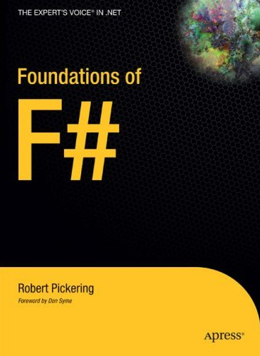


Books about F#
Visit research.microsoft.com/fsharp
blogs.msdn.com/dsyme

Slide 48
Parallel Technologies: Interactive Session
Parallel FX Task Parallel Library
Parallel FX PLINQ
Languages F#
Research F# Asynchronous Workflows
Research Joins Library
Robotics Studio CCR

Slide 49
Parallel Technologies: Interactive Session
TPL makes CPU Parallelism Simpler
PLINQ makes In-memory Data Parallel Queries Simpler
F# makes programming with less state simpler
F# Async Workflows make writing non-blocking code simpler
Joins makes implementing concurrent synchronization constructs simpler

Slide 50

Resources
Required slide:
Please customize this slide with the resources relevant to your session
Technical Communities, Webcasts, Blogs, Chats & User Groups http://www.microsoft.com/communities/default.mspx
Microsoft Learning and Certification http://www.microsoft.com/learning/default.mspx
Microsoft Developer Network (MSDN) & TechNet http://microsoft.com/msdn http://microsoft.com/technet
Trial Software and Virtual Labs http://www.microsoft.com/technet/downloads/trials/default.mspx
New, as a pilot for 2007, the Breakout sessions will be available post event, in the TechEd Video Library, via the My Event page of the website
learn
support
connect
subscribe
MSDN Library Knowledge Base Forums MSDN Magazine User Groups Newsgroups
E-learning Product Evaluations Videos Webcasts V-labs Blogs MVPs Certification Chats
Visit MSDN in the ATE Pavilion and get a FREE 180-day trial of MS Visual Studio Team System!
Notes:
Please customize this slide with the resources relevant to your session

Slide 51





Complete your evaluation on the My Event pages of the website at the CommNet or the Feedback Terminals to win!
All attendees who submit a session feedback form within 12 hours after the session ends will have the chance to win the very latest HTC 'Touch' smartphone complete with Windows Mobile® 6 Professional

Slide 52




© 2007 Microsoft Corporation. All rights reserved. This presentation is for informational purposes only. MICROSOFT MAKES NO WARRANTIES, EXPRESS OR IMPLIED, IN THIS SUMMARY.

